Slide 1


PROJECT REVIEW
HealthLink : ML-based Healthcare Assistant
Notes:
https://unsplash.com/photos/assorted-title-book-lot-on-shelf-_OZCl4XcpRw

Slide 2


Introduction
The overarching objective of the AI and ML-based Healthcare Assistant project is to leverage cutting- edge technologies to fundamentally enhance healthcare services.
At its core, the project aims to revolutionize patient care, accessibility, and overall health management. The specific goals encompass developing a Disease Prediction Model for accurate diagnoses, implementing a Drug Recommendation System
Introducing an empathetic AI Therapist for mental health support, creating a Nearest Hospital Finder for emergency medical assistance, and establishing an efficient Appointment Booking System to streamline healthcare consultations.
HEALTH-LINK
Disease Prediction
Drug Recommendation
Notes:
https://unsplash.com/photos/man-in-blue-scrub-suit-standing-near-white-and-black-office-rolling-chair-UNkNx6Hn9Fs

Slide 3


Objectives
The main three objectives of Healthlink are :
Enhancing Patient Care
The project aims to improve patient care through accurate disease prediction, personalized treatment recommendations, and empathetic mental health support.
HEALTH-LINK
The project seeks to enhance accessibility to healthcare services by providing a user-friendly platform for locating nearby hospitals, streamlining appointment bookings, and ensuring efficient communication between patients and healthcare professionals.
Increasing Accessibility
Optimization
The project will optimize health management by providing tailored and efficient healthcare solutions for individuals.
Notes:
https://unsplash.com/photos/man-in-blue-scrub-suit-standing-near-white-and-black-office-rolling-chair-UNkNx6Hn9Fs

Slide 4
MODULES
Disease Prediction Model
Personal Health Insights
Drug Recommendation System
Nearest Hospital Finder
HEALTH-LINK
User Authentication &
Management
AI Therapist
Admin Panel
Appointment Booking
AI and ML-based Healthcare Assistant, revolutionizing patient care through predictive disease analysis, personalized treatment recommendations, empathetic AI therapy, nearest hospital locator, and efficient appointment booking.
Notes:
https://unsplash.com/photos/man-in-blue-scrub-suit-standing-near-white-and-black-office-rolling-chair-UNkNx6Hn9Fs

Slide 5
Technology Stack
The technology stack used in this project includes
Machine Learning Frameworks: TensorFlow
Data Preprocessing Tools: Pandas, NumPy
Natural Language Processing (NLP) Libraries: NLTK
Geolocation Services: Google Maps API
Web Development Frameworks: Django (Fullstack)
Authentication and Authorization: Python
Database : MYSQL
Hosting : Render
HEALTH-LINK
Notes:
https://unsplash.com/photos/man-in-blue-scrub-suit-standing-near-white-and-black-office-rolling-chair-UNkNx6Hn9Fs

Slide 6
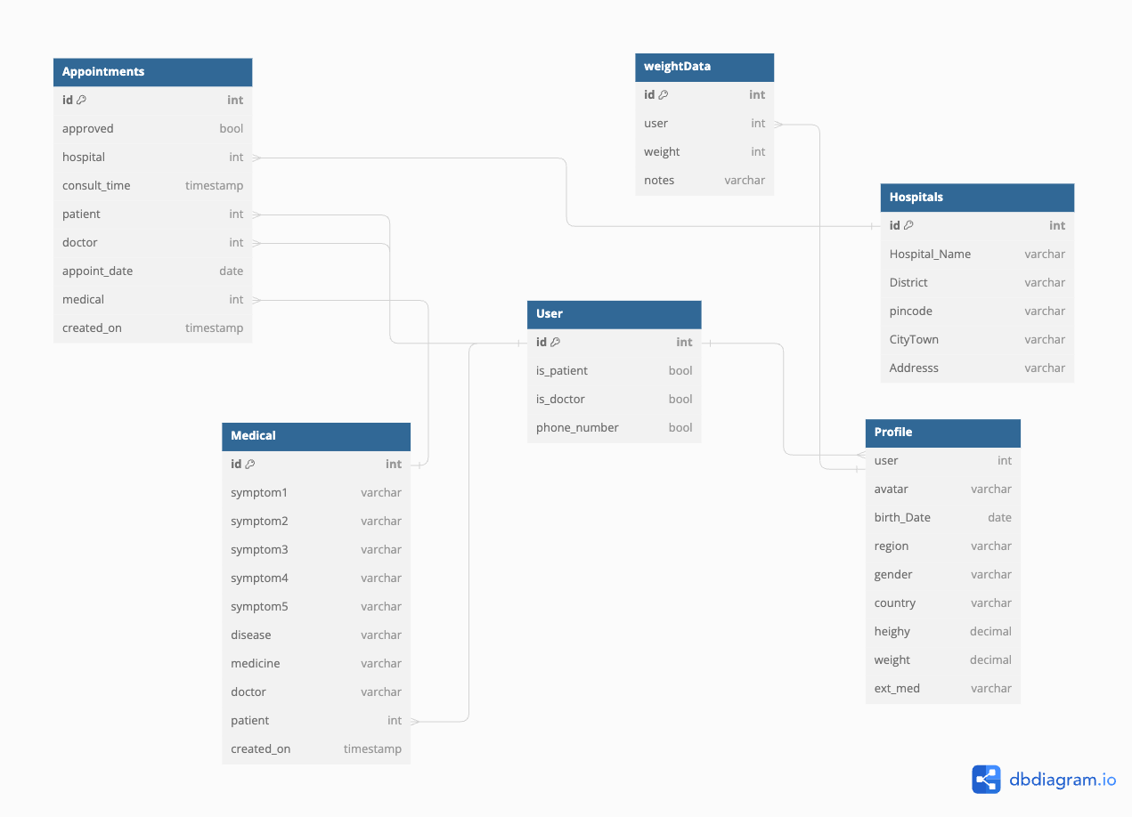
Database Design
HEALTH-LINK
Notes:
https://unsplash.com/photos/man-in-blue-scrub-suit-standing-near-white-and-black-office-rolling-chair-UNkNx6Hn9Fs

Slide 7
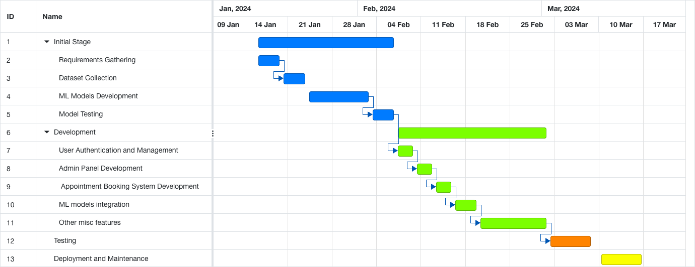
Gantt chart
Research Paper
Notes:
https://unsplash.com/photos/man-in-blue-scrub-suit-standing-near-white-and-black-office-rolling-chair-UNkNx6Hn9Fs

Slide 8
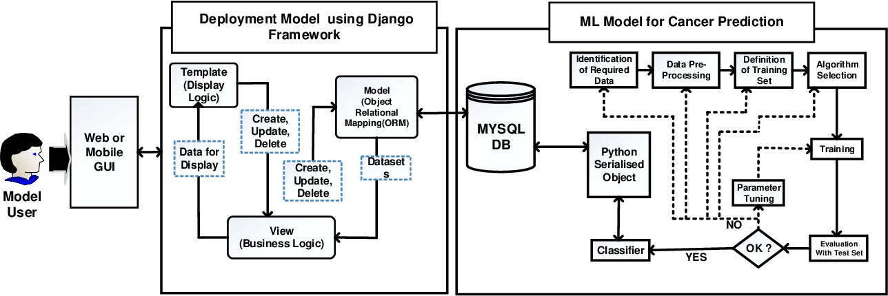
Architecture Digram
Research Paper
Notes:
https://unsplash.com/photos/man-in-blue-scrub-suit-standing-near-white-and-black-office-rolling-chair-UNkNx6Hn9Fs

Slide 9
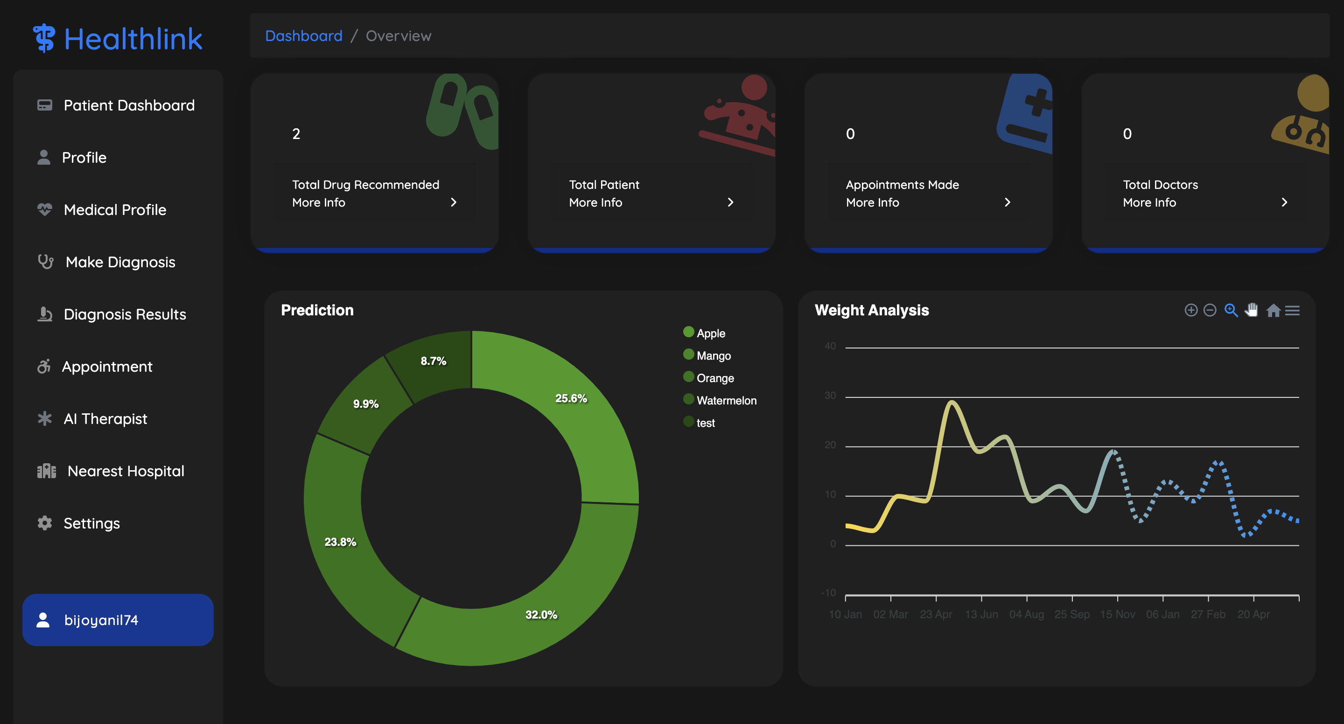
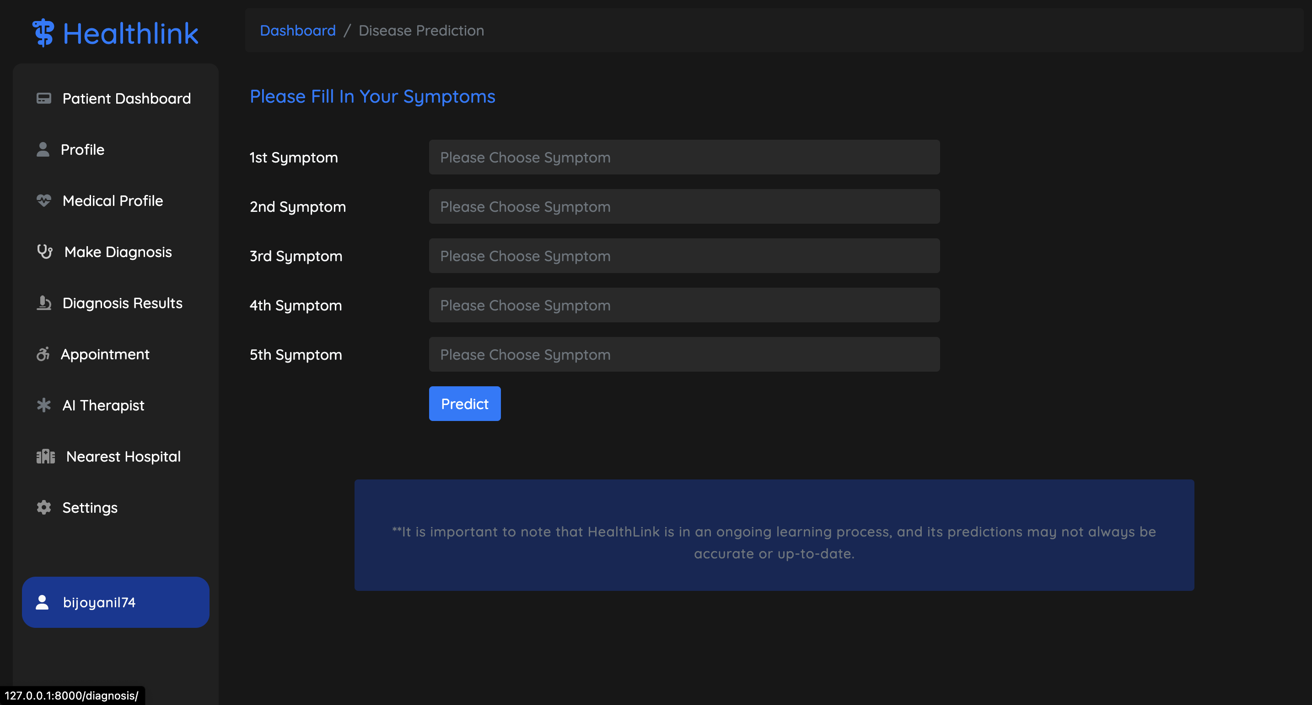
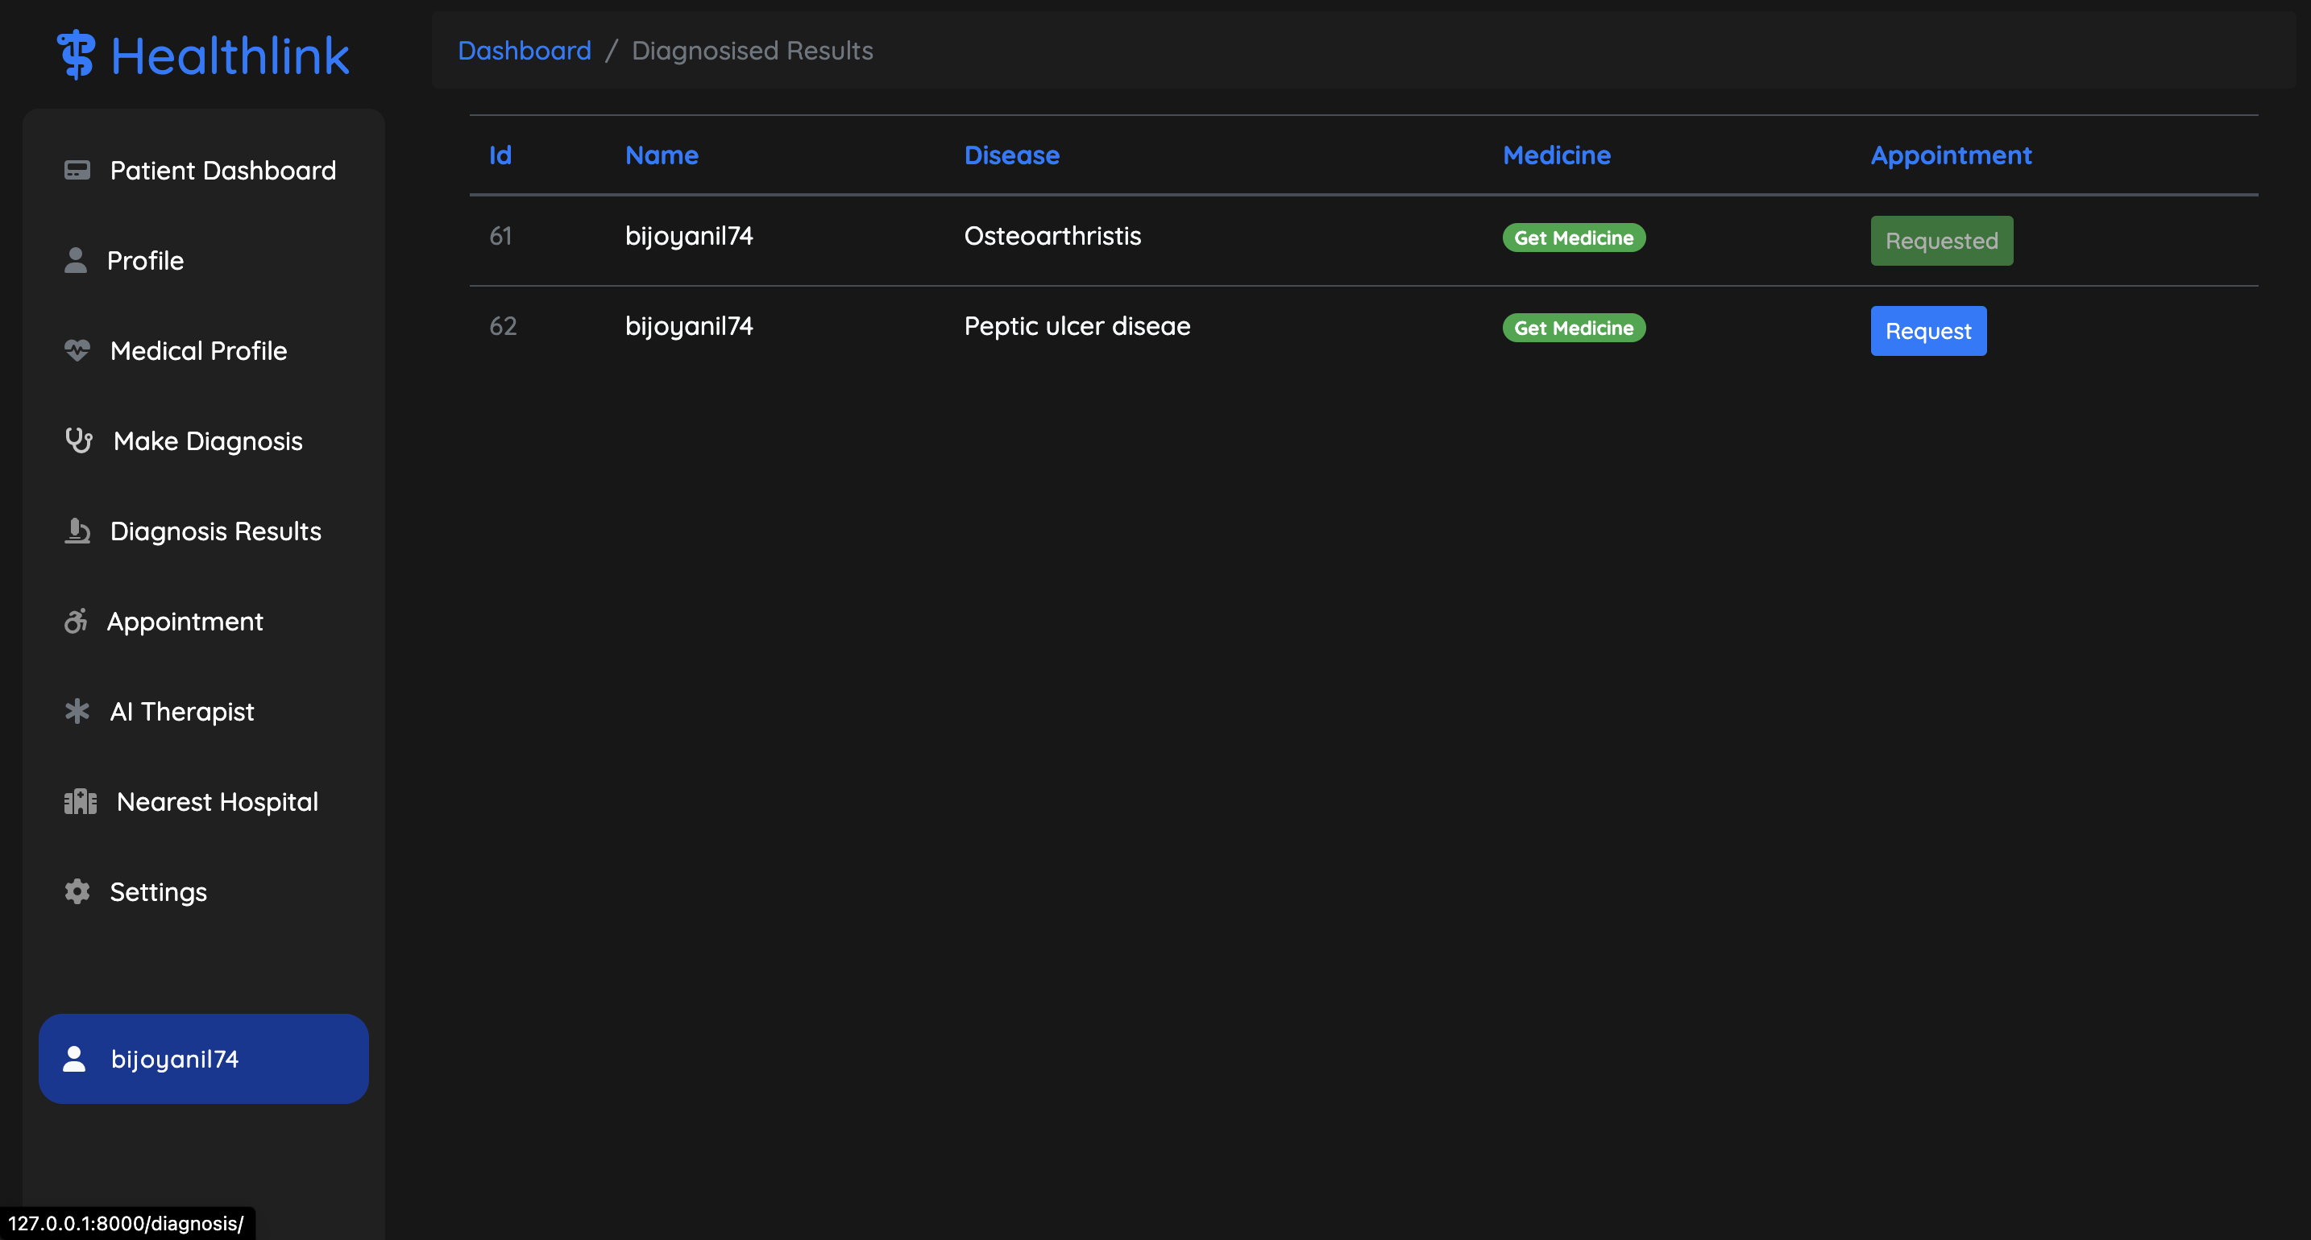
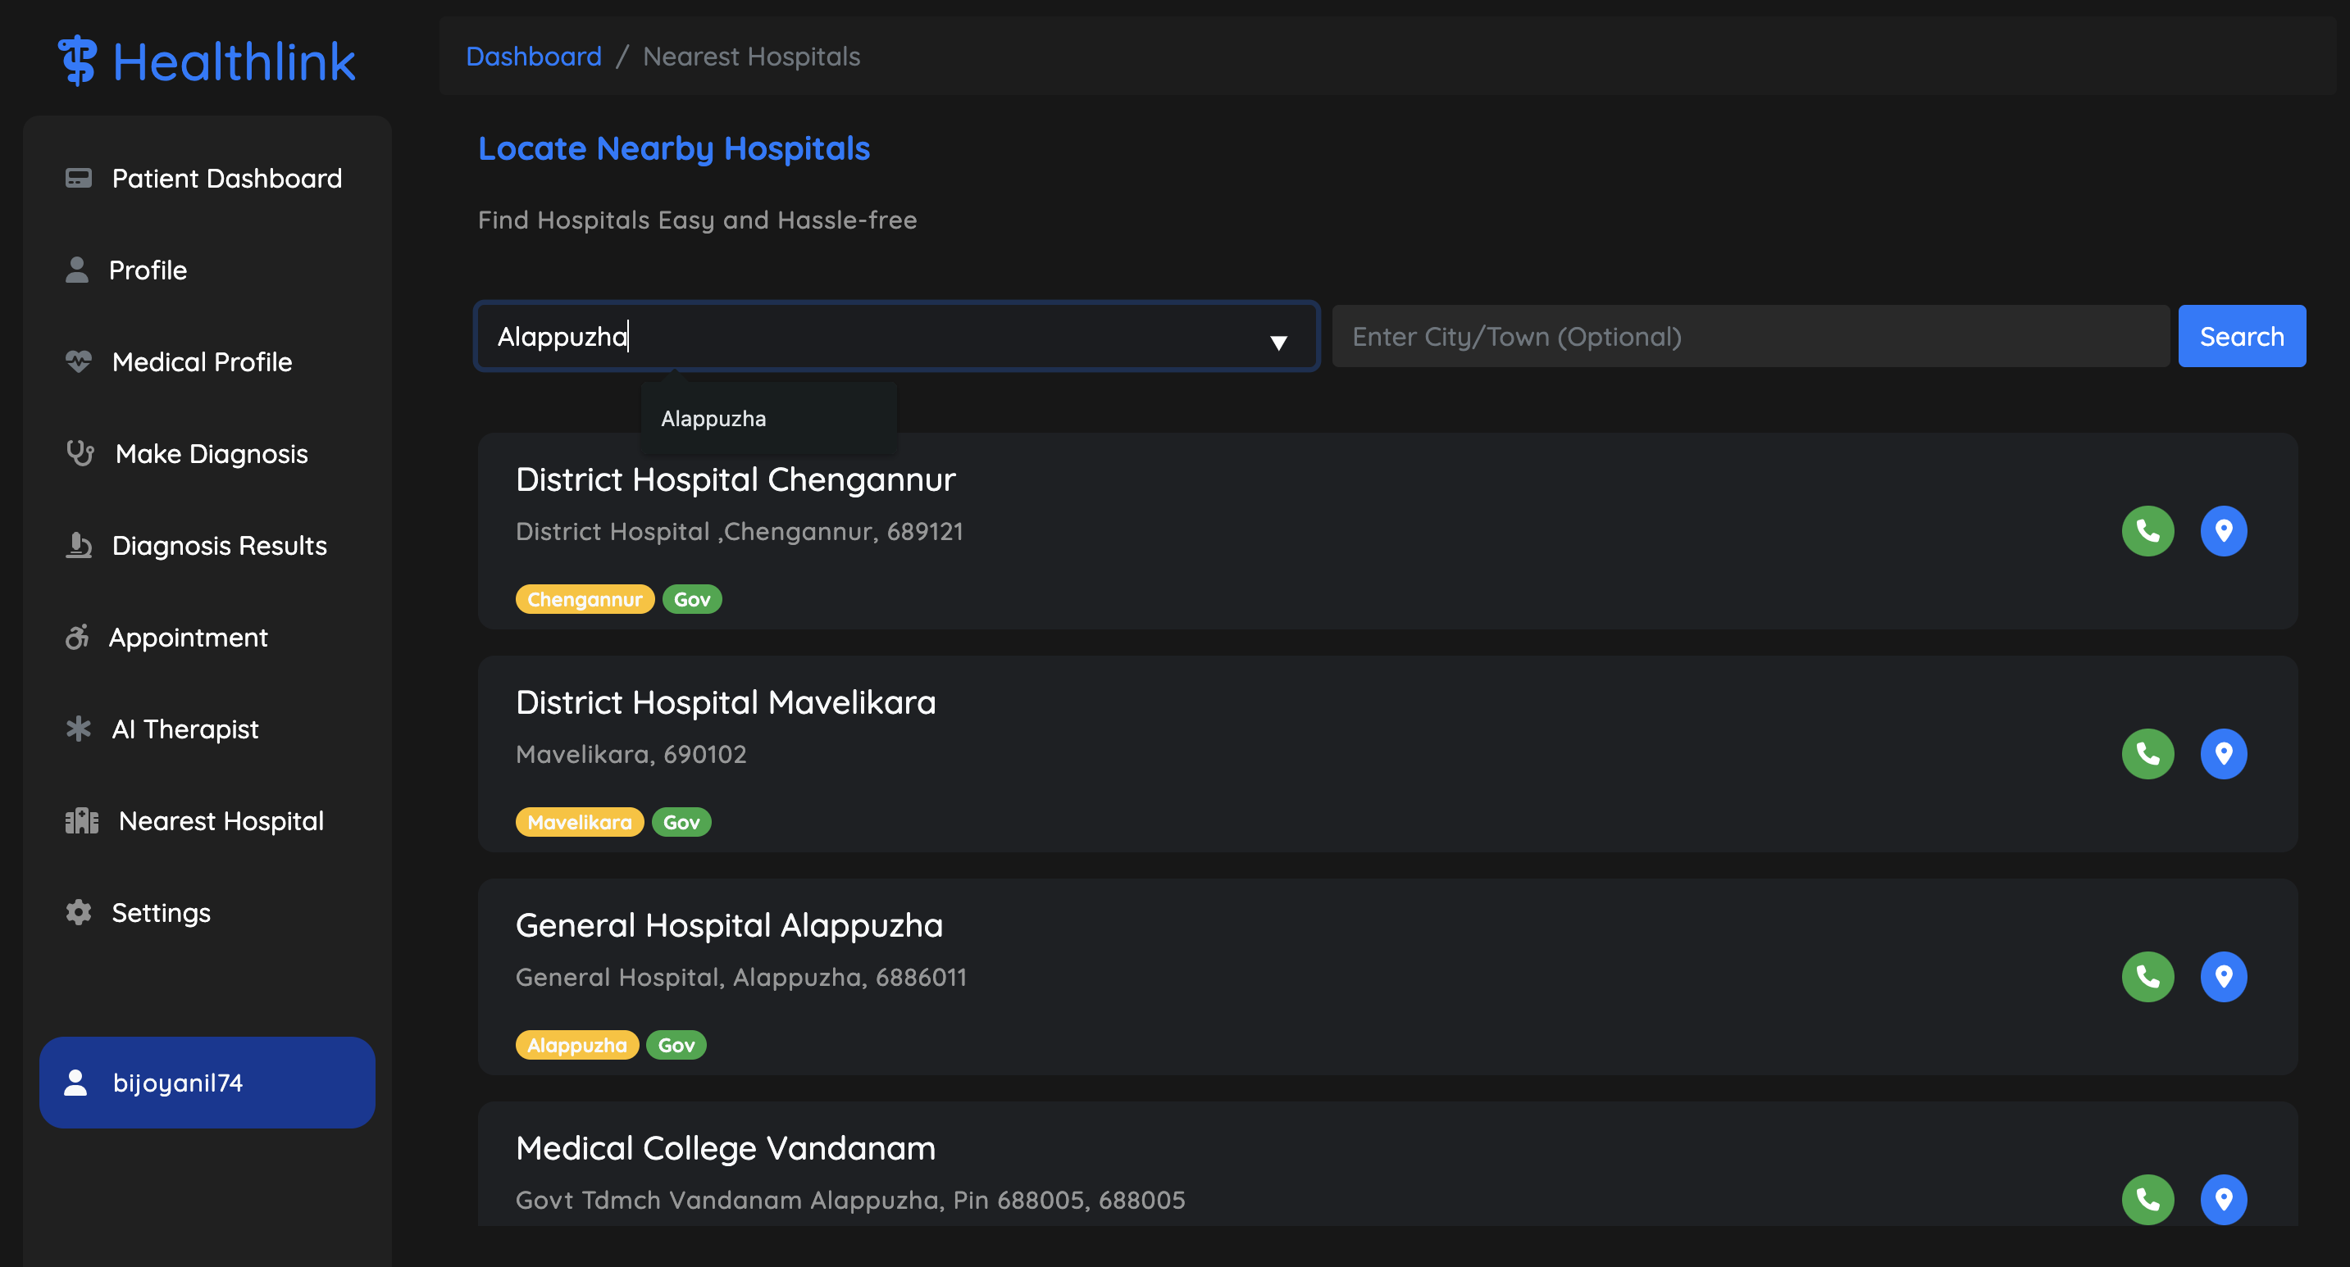
UI Design
Notes:
https://unsplash.com/photos/man-in-blue-scrub-suit-standing-near-white-and-black-office-rolling-chair-UNkNx6Hn9Fs

Slide 10
Algorithm Study
Algorithm Study - Naive Bayes (Disease Prediction)
Definition: Naive Bayes is a probabilistic classification algorithm based on Bayes' theorem with the assumption of independence between features.
Key Features: Simple and easy to implement. Efficient for large datasets. Handles missing data well.
Assumption: Features are conditionally independent given the class label.
Formula: P(y|x1, x2, ..., xn) = (P(y) * P(x1|y) * P(x2|y) * ... * P(xn|y)) / P(x1, x2, ..., xn)

Slide 11
Algorithm Study
Algorithm Study - Random Forest Algorithm (Drug recommendation)
Definition: Random Forest is an ensemble learning method based on decision trees, where multiple decision trees are constructed and their predictions are aggregated to make a final prediction.
Key Features: Ensemble method that reduces overfitting and variance. Builds multiple decision trees with random subsets of features and data. Provides feature importance for interpretability.
Formula: y​=mode(f1​(x),f2​(x),...,fN​(x))

Slide 12
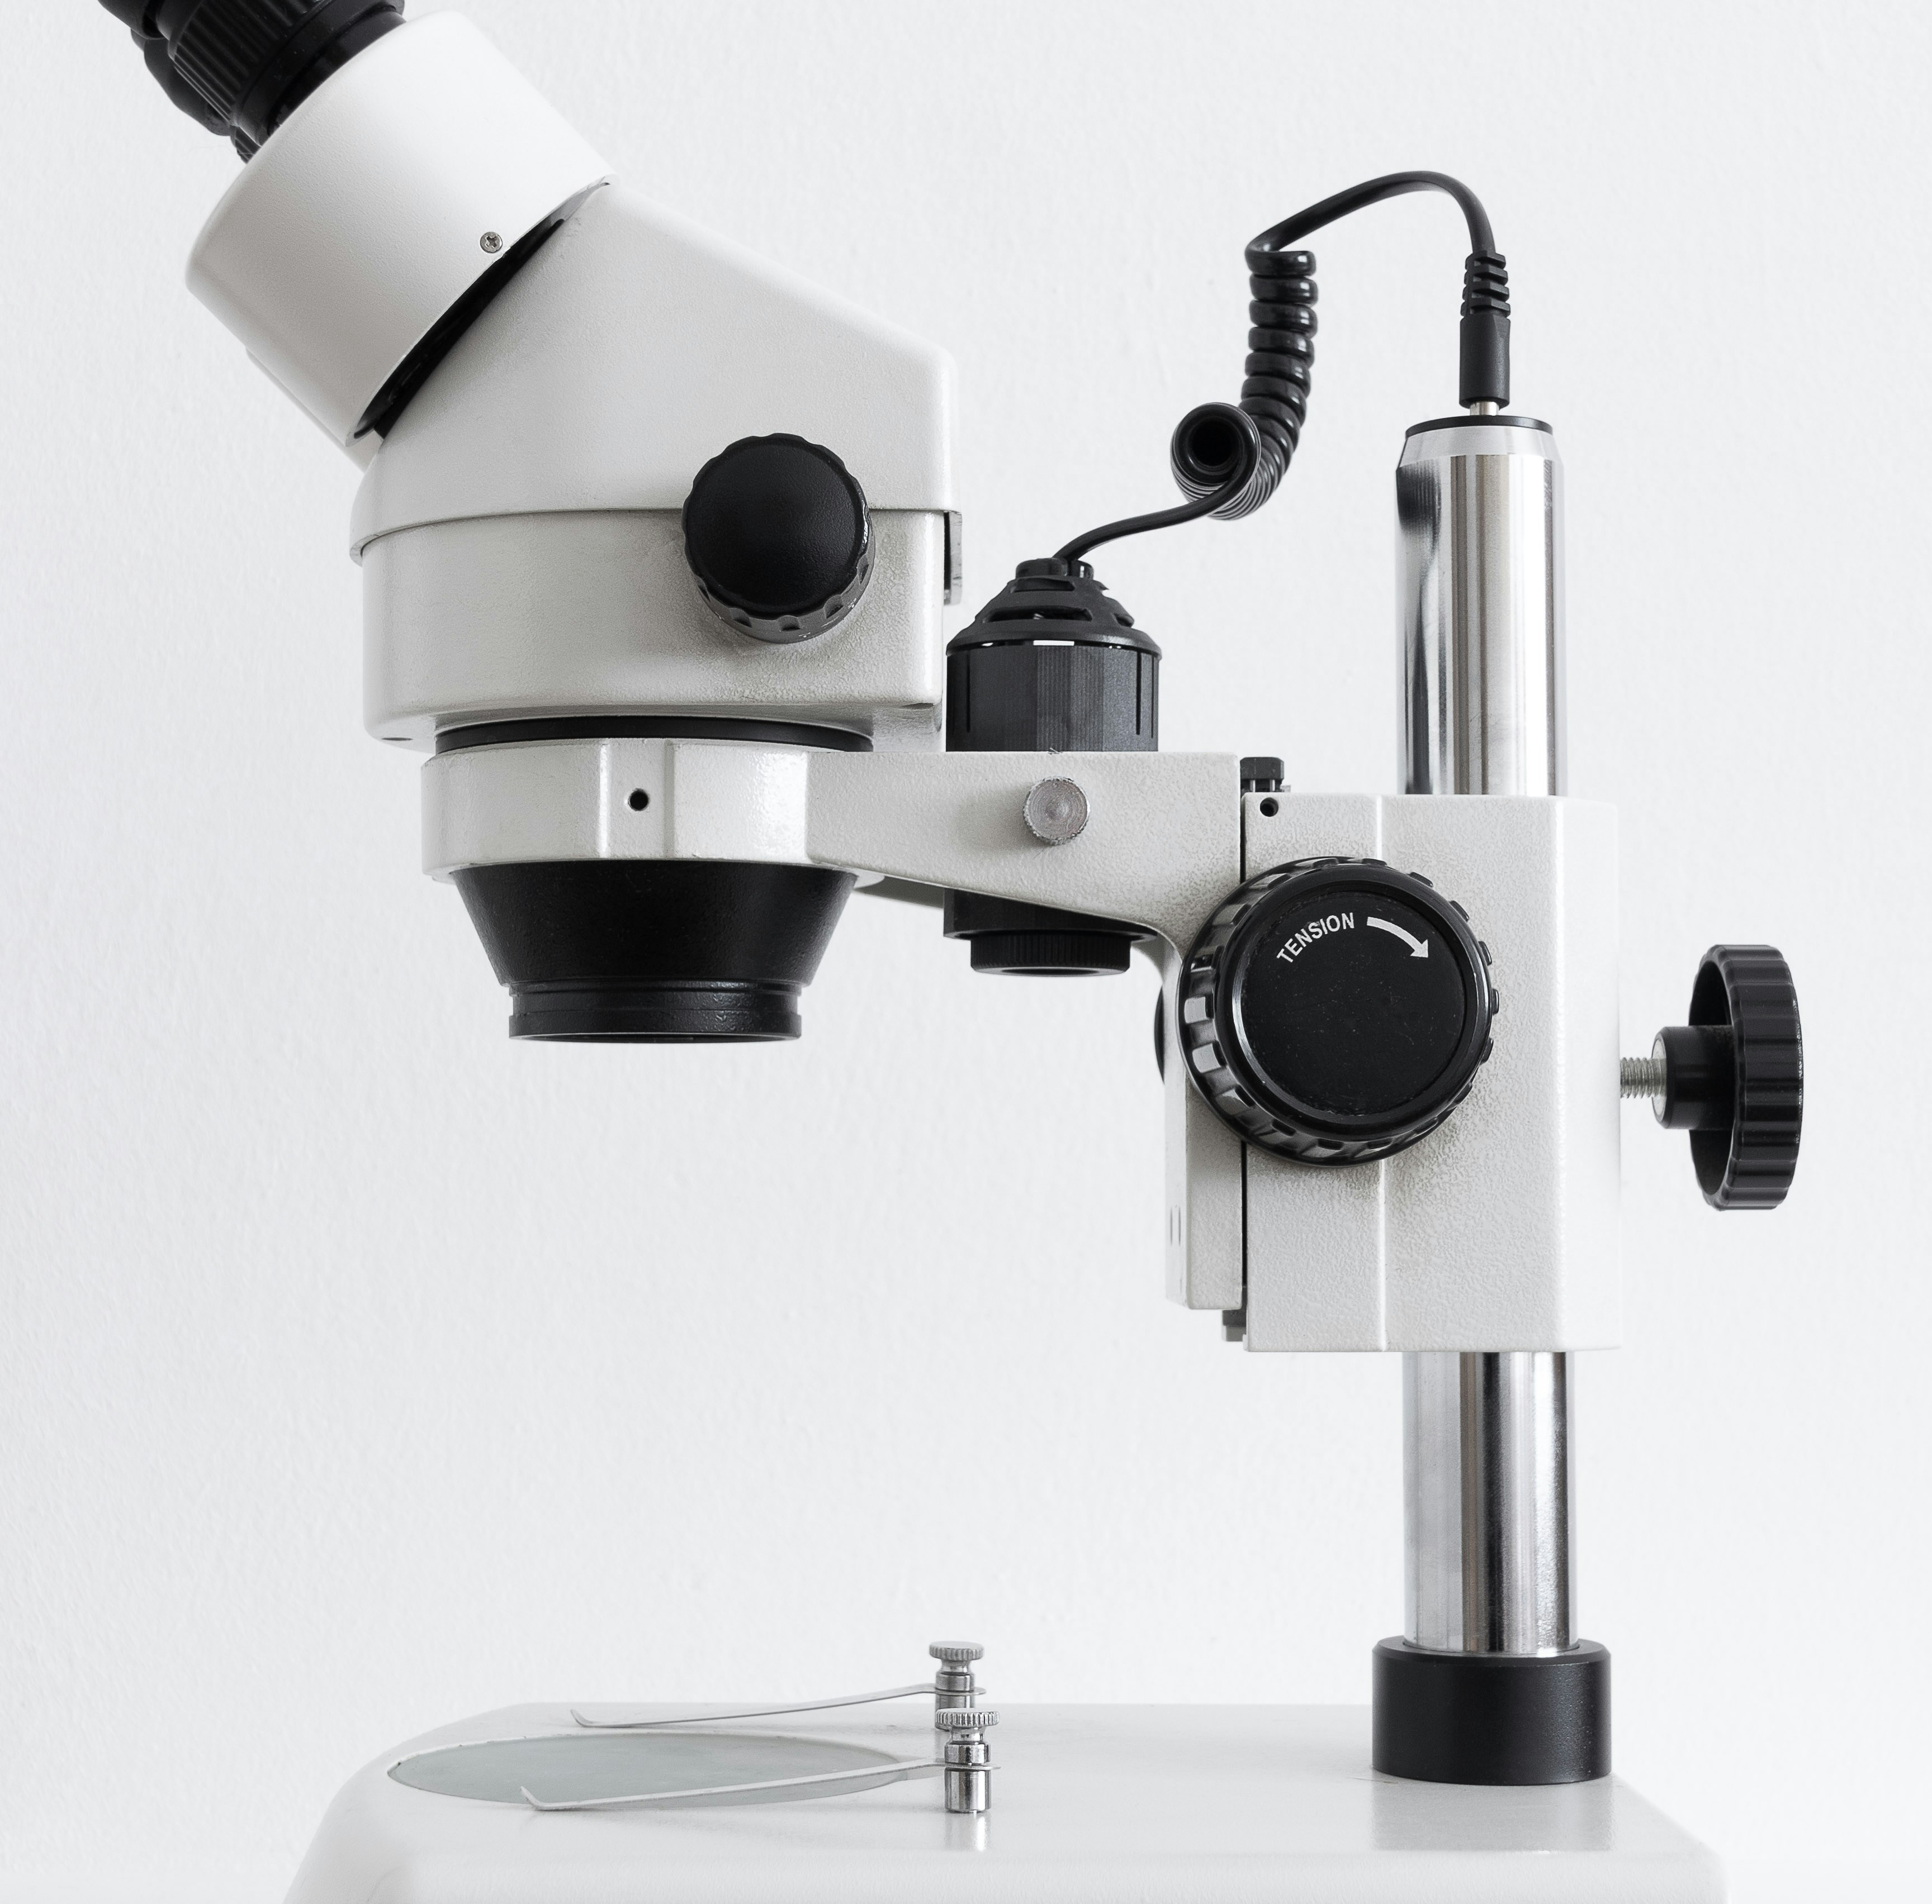
HEALTH-LINK
Thank You
Notes:
https://unsplash.com/photos/woman-wearing-blue-denim-jacket-holding-book-jCIMcOpFHig

